Slide 1
OwnershIP & Booting
And stuff

Slide 2

Agenda
Ownership
Permissions
Boot
SystemD

Slide 3
Ownership File meets user (AND/OR vice versa)

Slide 4
Viewing Ownership
To view the ownerships of a regular file, you can use the ls –l command:
[sysadmin@localhost ~]$ ls -l /etc/named.conf
-rw-r-----. 1 root named 1163 May 13 10:27 /etc/named.conf
To view the ownerships of a directory file, you can use the ls -ld command:
[sysadmin@localhost ~]$ ls -ld /etc/named
drwxr-x---. 2 root named 4096 Mar 28 2013 /etc/named
user owner
group owner
user owner
group owner

Slide 5
Viewing Ownership
Another command that allows you to view ownership information in a more detailed way is the stat command:
[sysadmin@localhost ~]$ stat /etc/named
File: `/etc/named'
Size: 4096 Blocks: 8 IO Block: 4096 directory
Device: fd00h/64768d Inode: 153995 Links: 2
Access: (0750/drwxr-x---) Uid: ( 0/ root) Gid: ( 25/ named)
Access: 2013-10-28 16:21:34.949997291 -0700
Modify: 2013-03-28 15:18:54.000000000 -0700
Change: 2013-05-13 09:56:53.831158705 -0700
user owner
group owner

Slide 6
File Ownership
Every file is owned by a user and a group.
If a user creates a file, they will be the user owner of that file.
The chown command can change user ownership of a file, but it can only be used by the root user.
Although most commands will show the user's account name as the owner, the operating system is actually associating that user’s UID as the file owner.

Slide 7
Group Ownership
When a file is created, the user's primary group is the group owner of the file.
The user can use the chgrp command to change the group owner of a file the user owns, to a group that the user is a member.
The root user can use the chgrp command to change the group owner of any file to any group.
While most commands will show a group name as the group owner, the system actually tracks group ownership by the GID of the group.

Slide 8
Orphaned Files
If a user is deleted, or has their UID changed, their former UID will show as the owner of their files.
If a group is deleted, or has its GID changed, the former GID will shown as the group owner of that group's files.

Slide 9
Identity Information

Slide 10
Finding Your Identity
To see the identity of your current account, and the your group memberships, execute the id command:
[sysadmin@localhost ~]$ id
uid=500(sysadmin) gid=500(sysadmin) groups=500(sysadmin),10001(research),10002(development) context=unconfined_u:unconfined_r:unconfined_t:s0-s0:c0.c1023 <= SELINUX KERNEL ENABLED
Also try the whoami command.

Slide 11
Viewing Group Membership
To list the names of the groups that you have memberships, run the groups command:
[sysadmin@localhost ~]$ groups
sysadmin research development
If you are added to a group while logged in, you will have to logout and back in again in order to see your new group membership

Slide 12
Changing File and Group Ownership

Slide 13
chown
The chown command can be used by the root user to change the user owner, the group owner, or both.
Ordinary users can not use chown to change the user / group owner of their files, but can use chgrp to change the group ownership.
Examples:
chown user:group <file|directory>
chown user <file|directory>
chown :group <file|directory>

Slide 14
chgrp
A user can change the group that owns the user's files to a group that they belong by using the chgrp command.
The root user can use the chgrp command to change the group owner of any file to any group or GID.
If the -R option is used with the chgrp command, it will be recursive, acting upon subdirectories and their contents, as well.

Slide 15
The newgrp Command
The newgrp command changes your effective primary group by opening a new shell with a different primary group.
You can join a new group IF YOU KNOW THE GROUP PASSWORD
Users can use the newgrp command to set the primary group to a group they belong before they create a file
The user can return to their original primary group by using the exit command
To permanently change the primary group of the user requires root execute the following command: usermod -g groupname username

Slide 16
Permissions : ownership & users (& processes !)

Slide 17
Permissions
When you execute the ls -l command, the first ten characters of each line are related to file type and permissions:
The first character indicates the file type.
Characters 2-4 are permissions for the user owner.
Characters 5-7 are permissions for the group owner.
Characters 8-10 are permissions for "others" or what is sometimes referred to as the world's permissions. This would be all users who are not the file owner or a member of the file's group.

Slide 18
Viewing Permissions
[root@localhost ~]# ls -l /etc/passwd
-rw-r--r--. 1 root root 4135 May 27 21:08 /etc/passwd
Based on the above command output, the first ten characters could be described by the following table:
File | User Owner |  |  | Group Owner |  |  | Others
Type | Read | Write | Execute | Read | Write | Execute | Read | Write | Execute
- | r | w | - | r | w | - | r | - | -

Slide 19
Types of Files (The first character)
Character | Type of the File
- | A regular file which may be empty, contain text or binary data.
d | A directory file which contains the names of other files and links to them.
l | A symbolic link is a file name that refers (points) to another file.
b | A block file is one that relates to a block hardware device where data is read in blocks of data.
c | A character file is one that relates to a character hardware device where data is read one byte at a time.
p | A pipe file works similar to the pipe symbol, allowing for the output of one process to communicate to another process through the pipe file, where the output of the one process is used as input for the other process.
s | A socket file allows two processes to communicate, where both processes are allowed to either send or receive data.

Slide 20
Meaning of Permissions
Permission | Meaning on a file | Meaning on a directory
r | The process can read the contents of the file, meaning the contents can be viewed and copied. | File names in directory can be listed, but other details are not be available.
w | The file can be written to by the process, so changes to a file can be saved. Note that w permission really requires r permission on the file to work correctly. | Files can be added to or removed from the directory. Note that w permission requires x permission on the directory to work correctly.
x | The file can be executed or run as a process. | The user can use the cd command to "get into" the directory and use the directory in a pathname to access files and, potentially, subdirectories under this directory.

Slide 21
Understanding Permissions
Only one of the three sets of permissions will apply when a user attempts some kind of access on a file:
If you are the user that owns the file, then only the user owner (first 3) permissions apply.
If you are not the user owner, but are a member of the group that owns the file, the group owner (second 3) permissions apply.
If you are not the user owner and you are a not a member of the group that owns the file, then the permissions for the “others” (last 3) will apply.

Slide 22
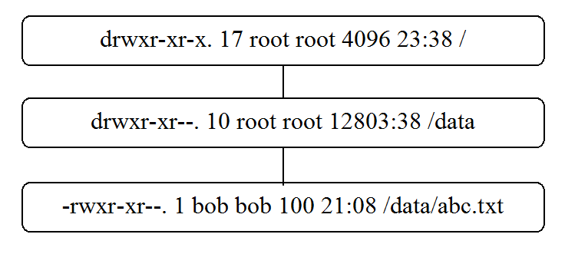
Importance of Directory Access
Question: What level of access does bob have to /data/abc.txt?
None, because without execute permission on /data there is no way for bob to access the /data/abc.txt file.

Slide 23
chmod Command

Slide 24
chmod
The chmod (change mode) command is used to set or modify permissions.
To change permissions on a file, you must either be the user owner or root.
There are two distinct techniques for changing permissions with chmod:
symbolic
numeric

Slide 25
Using chmod symbolically
With this technique, you specify who, an operator, and what:
who: specifies whose permissions to alter:
u for user
g for group
o for others
a for everyone
operator: specifies whether to add, remove or assign:
+ to add
- to remove
= to set exactly
what: specifies the permission to set on the file:
r for read
w for write
x for execute
- for nothing

Slide 26
chmod symbolic (alter) examples
chmod u+x abc.txt
will alter the execute permission for the user owner.
chmod go-rx abc.txt
will alter/remove read and execute for the group owner and others owner.
chmod u+wx,g=rx,o-r abc.txt
will alter the write and execute permissions for the user owner (no change to read), will set r-x for group owner and alters/removes read permission for “others”.

Slide 27
Using chmod (set) numerically
When using the numeric technique with chmod, a three digit number is used to represent the permissions of the user, group and others.
It is also called the octal method after the octal values that are used to calculate the permissions:
4 = read
2 = write
1 = execute

Slide 28
Using chmod numerically
By combining the permissions the values range from 0 to 7:
7 = rwx
6 = rw-
5 = r-x
4 = r--
3 = -wx
2 = -w-
1 = --x
0 = ---
All nine permissions must be specified when using the octal method:
777 = rwxrwxrwx
775 = rwxrwxr-x
755 = rwxr-xr-x
700 = rwx------
664 = rw-rw-r--
640 = rw-r-----

Slide 29
chmod numeric examples
chmod 755 abc.sh
rwxr-xr-x
chmod 660 abc.txt
rw-rw----
chmod 771 somedir
for rwxrwx--x
chmod 400 my.txt
r--------
chmod 700 userdir
rwx------

Slide 30
umask Command

Slide 31
Understanding umask
The umask value is used to determine the default permissions that are set when a new file or directory is created.
Default permissions are determined by removing permissions in the umask from the maximum allowable permissions.
The maximum allowable permissions for:
a new file is rw-rw-rw- or 666
a new directory is rwxrwxrwx or 777

Slide 32
User umask example
Typical user umask
 | Directory |  | File
Maxium Allowable Permission | rwxrwxrwx | 777 | rw-rw-rw- | 666
umask value | -------w- | 002 | -------w- | 002
Default permission | rwxrwxr-x | 775 | rw-rw-r-- | 664
With a typical user umask value of 002, the others set of permissions has write permission removed.

Slide 33
Root umask example
Root user umask
 | Directory |  | File
Maxium Allowable Permission | rwxrwxrwx | 777 | rw-rw-rw- | 666
umask value | ----w--w- | 022 | ----w--w- | 022
Default permission | rwxr-xr-x | 755 | rw-r--r-- | 644
With a root user umask value of 022, the group and others sets of permissions have write permission removed.

Slide 34
Private umask example
umask for privacy
 | Directory |  | File
Maxium Allowable Permission | rwxrwxrwx | 777 | rw-rw-rw- | 666
umask value | ---rwxrwx | 077 | ---rwxrwx | 077
Default permission | rwx------ | 700 | rw------- | 600
With umask value of 077, the group and others sets of permissions have all permissions removed.

Slide 35
Using umask
To display the current umask value, execute umask with no arguments.
To set umask to a value of 027, type umask 027
The new umask value will only apply during the current login session.
When a new shell is started, your default umask will be in effect again.
To set a new default umask, modify ~/.bashrc
The umask value has no effect on existing files or directories, but applies to new files or directories.

Slide 36
Extending permissions : Access control list (acl)

Slide 37
WHY ACL ?
Because o(thers) = “the rest of the world” can be a big place
E.g. a process like a web server can be granted access to files that reside in a user's home directory, without compromising security by giving the whole world access

Slide 38
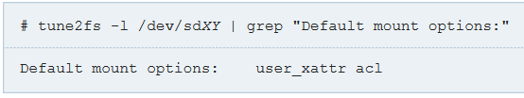
Enabling ACL
To enable ACL, the filesystem must be mounted with the acl option.

Slide 39



Setting ACL
The ACL can be modified using setfacl
You will notice that there is an ACL if there is a plus sign after its Unix permissions in the output of ls -l.

Slide 40

Granting permissions for private files to a Web Server
In the following we assume that the web server runs as the user webserver and grant it access to geoffrey's home directory /home/geoffrey.
The first step is granting read+execution permission to webserver so it can access geoffrey's home:

Slide 41

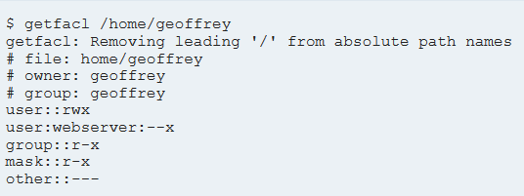
Granting permissions for private files to a Web Server
Since webserver is now able to access files in /home/geoffrey, other no longer needs access, so it can be safely removed:
getfacl can be used to verify the changes:

Slide 42
setuid Permission

Slide 43
The setuid Permission
The setuid permission is set on certain system utilities so that an ordinary user can execute the program as if it was run by the root user. This allows an a normal user to perform common system administration tasks without having to do gain direct access to the root account.
An excellent example of the setuid permission in action is the /usr/bin/passwd command. When a user executes the passwd command successfully, the command is able to update the /etc/shadow file to set a new password for the user. This file can’t be accessed normally by no-root users.

Slide 44
Files with setuid
A file that has setuid permission properly set will have a lowercase "s" in the “user owner” execute position, indicating both setuid and execute permission for the user owner are set:
-rwsr-xr-x
A file which has setuid permission, but lacks execute permission for the user owner will show an uppercase "S" to highlight that the permission is not effective:
-rwSr-xr-x

Slide 45
Using chmod with setuid
The chmod command can be used to set or remove the setuid permission
Setting setuid :
chmod u+s file
Removing setuid :
chmod u-s file

Slide 46
setgid Permission

Slide 47
The setgid Permission on a File
The setgid permission used on a file is similar to setuid except that it uses group permissions. When a user executes a file that is setgid, the system runs the command as if the user were a member of the group that owns the executable, usually granting access to additional files.
An example of setgid permission on a file is the /usr/bin/wall command. The wall command sends messages to other user’s terminals. Since this executable is owned by the "tty" group, when it is run it grants the user access to the files owned by the "tty" group, which effectively allows the user to write a message to any "tty" or terminal on the system.

Slide 48
The setgid Permission on a Directory
Using setgid permission on a directory is used by administrators to make it easier for users who are in a group to be able to share files with other users in the same group.
When setgid permission is set on a directory, any files created in that directory are automatically group owned by the group that owns the directory.
When a new subdirectory are created in a directory that has setgid, the new subdirectory will also have setgid permission and be group owned by the group that owns the parent directory.

Slide 49
Files with setgid
A file that has setuid permission properly set will have a lowercase "s" in the group owner execute column, indicating both setgid and execute permission for the user owner is set:
-r-xr-sr--
A file which has setgid permission, but lacks execute permission for the group owner will show as an uppercase "S" to highlight that the permission is not effective:
-r-xr-Sr--

Slide 50
Using chmod with setgid
The chmod command can be used to set or remove the setgid permission
Setting setgid
chmod g+s file
Removing setgid
chmod g-s file

Slide 51
Working with the Sticky Bit

Slide 52
The sticky bit Permission
The sticky bit permission is used to prevent others from deleting files that they do not own in a directory that is shared with others.
Normally, if a user has write permission on a directory, then that user can delete any file in that directory, including files that user does not own, regardless of the permissions of the file.
The classic example of a directory that normally has the sticky bit permission is the /tmp directory. This directory is standard on all Linux systems and provides a place were all users can store files. With sticky bit set, one user can't delete another user's /tmp files.

Slide 53
Directories with the sticky bit set
When the sticky bit permission is set and the others can execute (cd to) the directory, the letter "t" will appear in the execute column for the others: drwxrwxrwt
Unlike setuid and setgid, where a capital letter indicated a problem that would prevent those permissions from working, the presence of an uppercase letter "T" does not always mean that the sticky bit permission is not set correctly: drwxrwx--T
If either the user owner or group owner have execute permission, then it is possible for the sticky bit permission to work as intended for those accounts.
If only the user owner has execute permission, then the sticky bit permission doesn’t make sense: drwx------T

Slide 54
Using chmod with sticky bit
The chmod command can be used to set or remove the sticky bit permission
Setting sticky bit
chmod o+t dir
Removing sticky bit
chmod o-t dir

Slide 55
The boot process

Slide 56
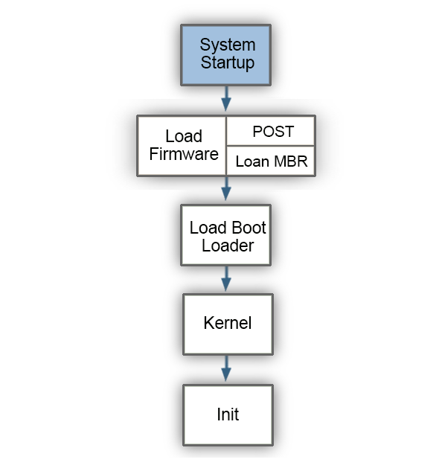
Boot Process Overview
Four main stages
Some stages can be modified by administrators
SystemD
Notes:
Aligns to 16.1

Slide 57
Firmware Stage
Firmware is referred to as the BIOS (Basic Input Output System)
UEFI (Unified Extensible Firmware Interface) has replaced the BIOS on most systems but typically still referred to as “BIOS”
Notes:
Aligns to 16.2

Slide 58
Firmware Stage
Two primary jobs in this stage:
1) Power-On Self Test (POST) – ensures system hardware (CPU, RAM, peripherals, etc.) is functioning properly
2) Load Master Boot Record (MBR) – contains drive partition table and loads first stage bootloader whose purpose is to load the second stage booloader (next stage)
Notes:
Aligns to 16.2

Slide 59
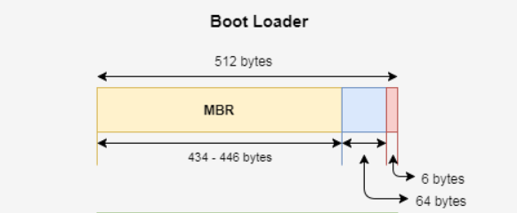
First Stage Boot Loader
BIOS looks for Master Boot Record (MBR) on first found hdd or equivalent – finds partition table and loadsfirst stage bootloader
Max 446 bytes!
64 bytes Partition Table, 6 bytes crc
That bootloader will load the second stage bootloader, who lies elsewhere
* (exceptionally this First stage bootloader loads kernel directly)
Notes:
Aligns to 16.2

Slide 60
First Stage Bootloader
Most common bootloaders
- LILO - Linux Loader
*Supports systems with BIOS
*ELILO – Efi Linux Loader supports systems with UEFI
- GRUB - Grand Unified Bootloader
*Supports systems with UEFI
*Supports Kernel Flavor choice
Notes:
Aligns to 16.3

Slide 61
First Stage Bootloader
Other bootloaders
- SILO – SPARC Improved bootLoader
*Supports Linux on Sun SPARC hardware
-YABOOT – Yet Another Bootloader
Supports PowerPC hardware
Network booting
- PXE– Preboot Execution Environment
*For hardware that supports TFTP used to download the bootloader from a server
Notes:
Aligns to 16.3

Slide 62
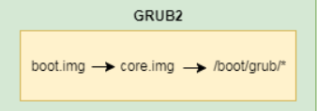
GRUB2
Boot.img (1st stage bootloader)
<512 bytes on MBR
Points to location of core.img
Core.img (2nd stage | 1,5th stage bootloader)
Chosen Kernel image + generic modules to
Access files in /boot/grub (the REAL 2nd stage ?)
Loads other (kernel) modules at runtime
Notes:
Aligns to 16.4

Slide 63
Kernel phase
GRUB2 loads the chosen kernel in memory and passes control to it using the files in
the /boot directory :
An initial RAM disk image (initrd / initramfs)
temporary / as tmpfs ←!!!
the kernel files (vmlinuz) with basic devices
Kernel start up : SystemD becomes active
PID 1
Notes:
Aligns to 16.5

Slide 64
SystemD phase
Set kernel options using /etc/sysctl.conf
Starts udevd daemon to detect all (other) devices
Imports network configuration
file system check (fsck) the root file system if necessary
Notes:
Aligns to 16.5

Slide 65
SystemD phase
Decrypts filesystems if encrypted.
Mount filesystems according to /etc/fstab
the REAL (root) / is mounted
Enable swap devices
Eventually
The system boots in a specific target mode
SystemD is managed by systemctl command
Notes:
Aligns to 16.5

Slide 66
dmesg Command
Executed after boot to view messages generated by the kernel during the boot process
Useful for troubleshooting boot issues
Also executed upon connecting a new device to see device pathname
Notes:
Aligns to 16.6

Slide 67
/var/log/messages File
Kernel boot messages are stored in /var/log/dmesg which is overwritten each time the system boots
- /var/log/syslog on some distributions
File updated traditionally by syslogd and klogd daemons
Syslogd and klogd have been replaced by rsyslogd and syslog-ng daemons
Notes:
Aligns to 16.7

Slide 68
Services & targets

Slide 69
Daemons
The administrator can control which services will be provided by the various daemons
A daemon is a running program that provides a service
Notes:
Aligns to 18.6

Slide 70
The systemctl command
The systemctl command is used in systems that have Systemd
Services are a type of systemD unit
Configured in /etc/systemd/system
.service files
To start a service:
#systemctl start httpd.service
To stop a service:
#systemctl stop httpd.service
Notes:
Aligns to 18.11

Slide 71
The systemctl command
To start check the state of a service:
#systemctl status httpd.service
To view all running services:
#systemctl -a
To configure a service to start automatically:
#systemctl enable httpd.service
Notes:
Aligns to 18.11

Slide 72
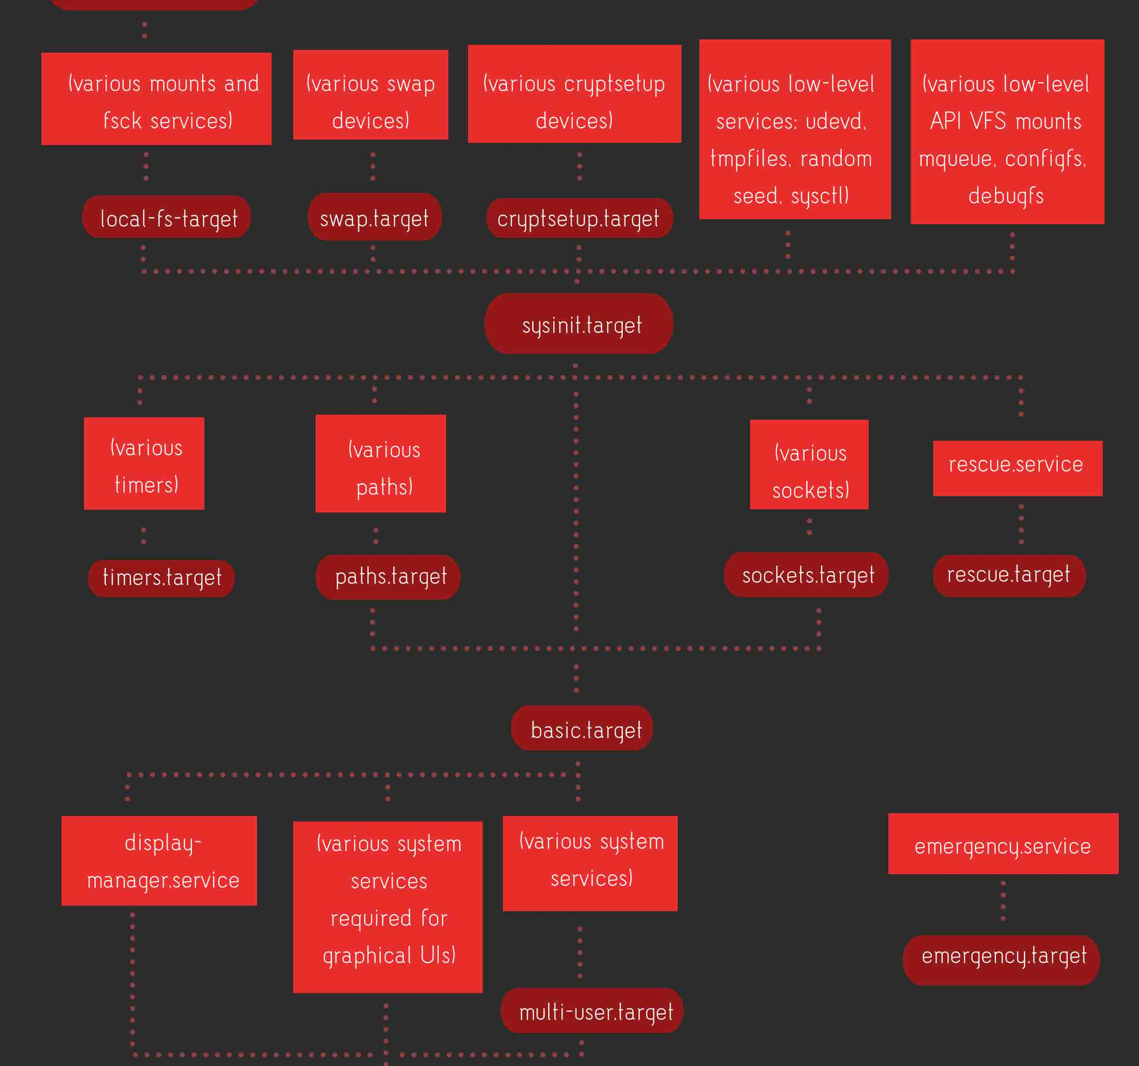
Targets
A Target is a state where a consistent number of services are running
A target has
Required dependencies
Parallel dependencies
Conflicting dependencies
Sequential dependencies (Before / After)

Slide 73
# systemctl isolate graphical.target
The systemctl command
To change the current target state
#systemctl isolate graphical-target
To change the default target state
#systemctl set-default multi-user.target
Notes:
Aligns to 18.11

Slide 74
# systemctl isolate graphical.target
Next Week
Create your own
BIOS Firmware
Create your own
SystemD Service
Some prep work required !
You’ll need a full graphical Debian instance (yes, not just the console this time, install the works!)
Install the following packages (open a termit console and as root install sudo)
And then
sudo apt install -y bison build-essential curl flex git gnat libncurses5-dev m4 zlib1g-dev qemu qemu-system-x86 python php
Notes:
Aligns to 18.11

